Slide 1
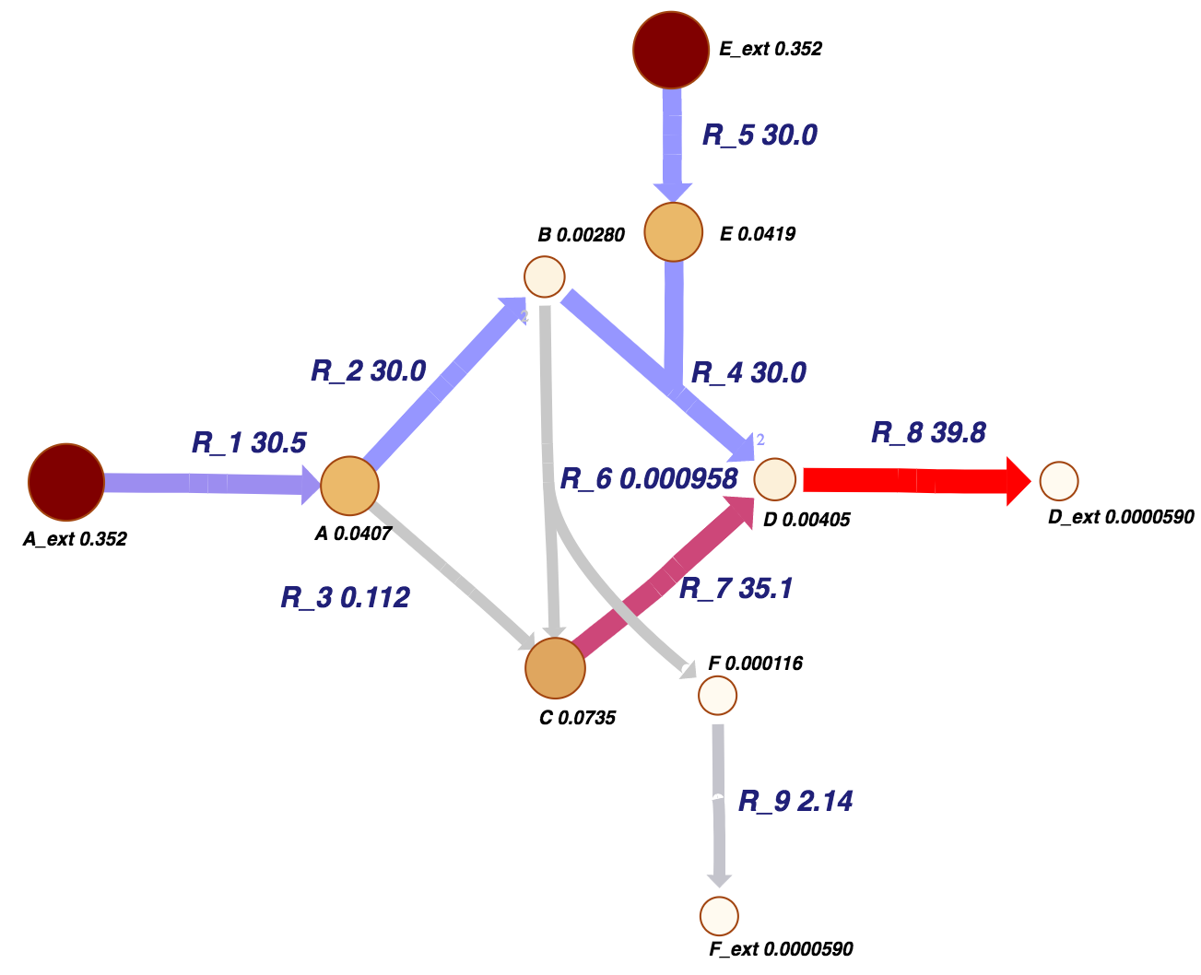
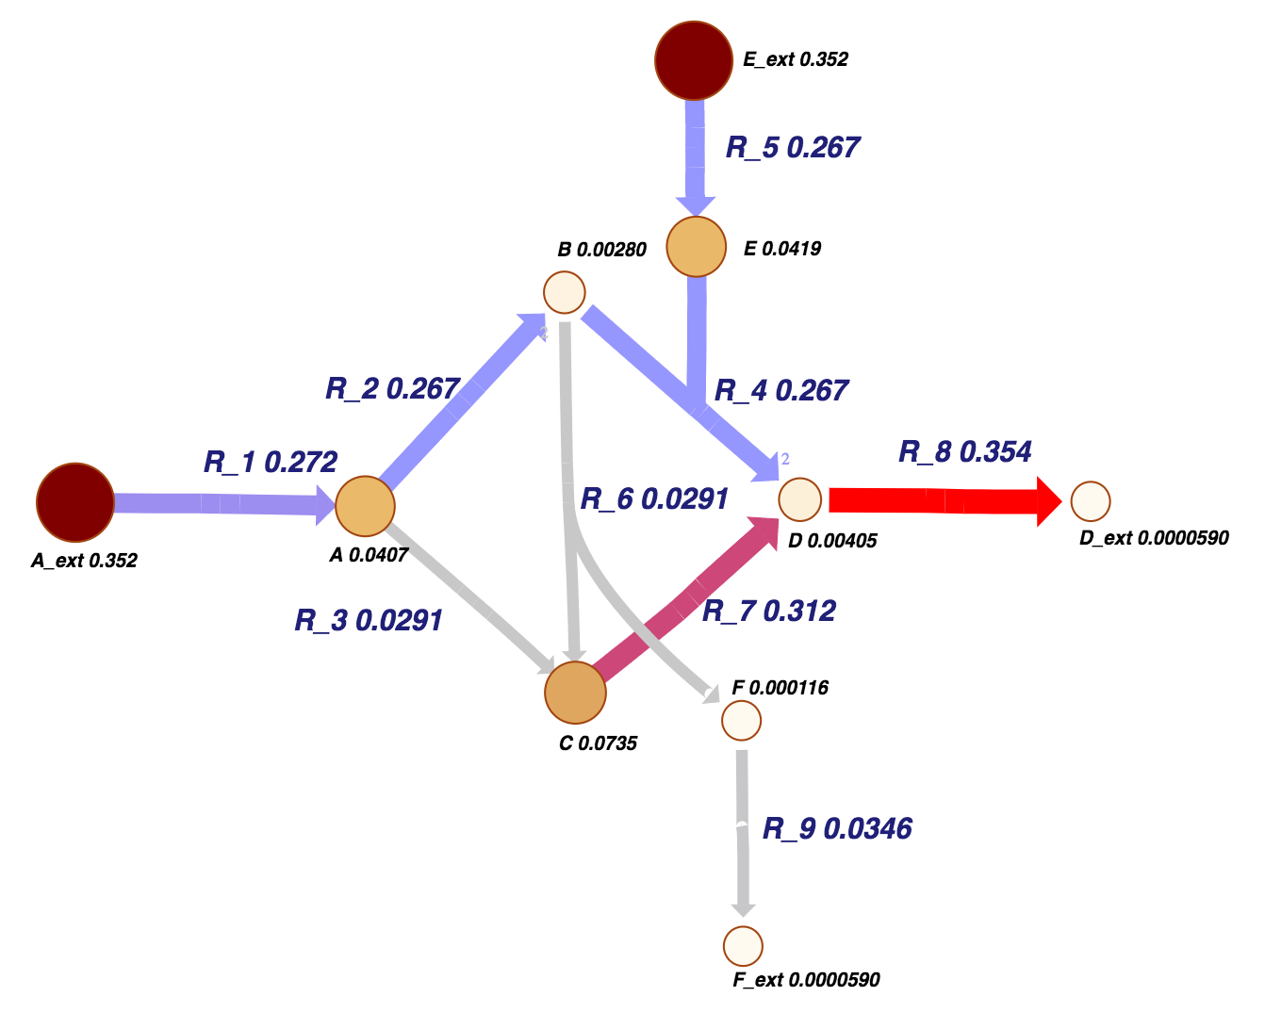
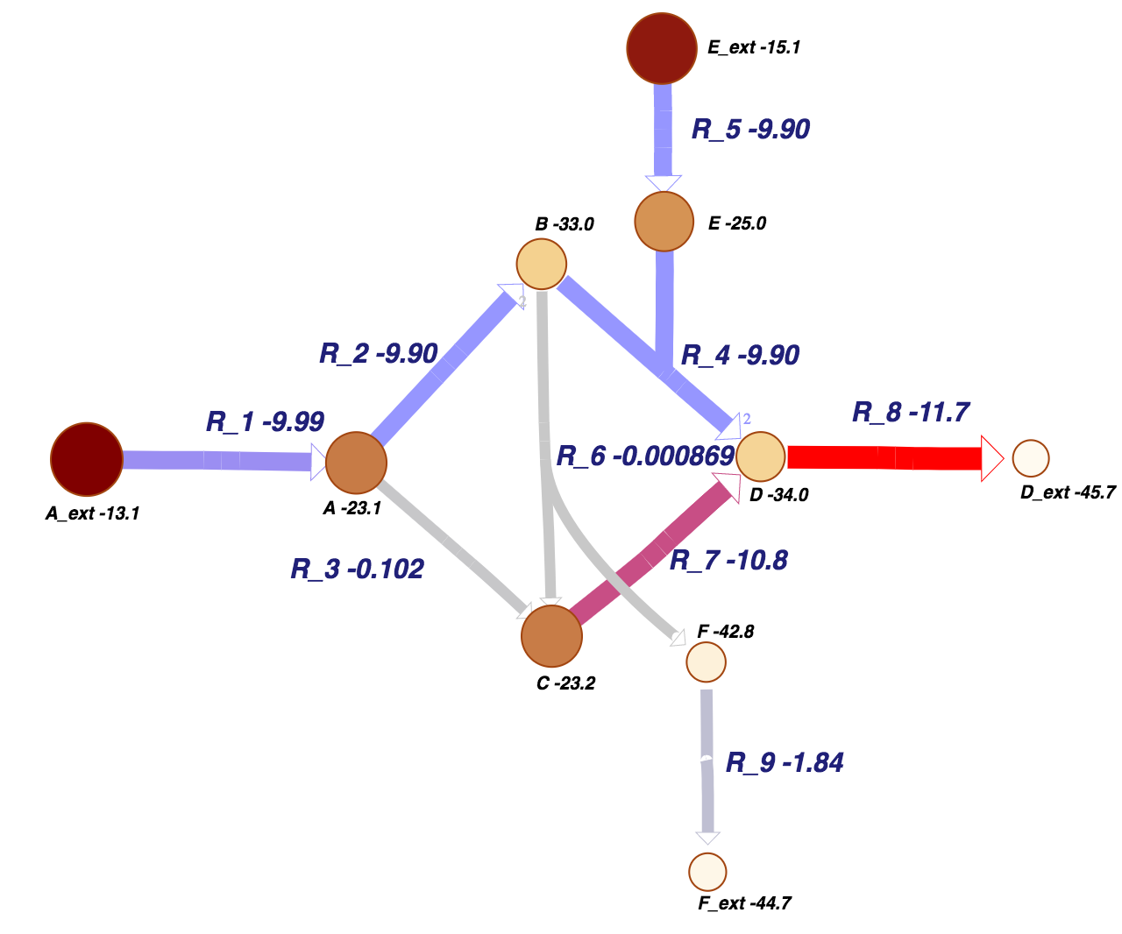
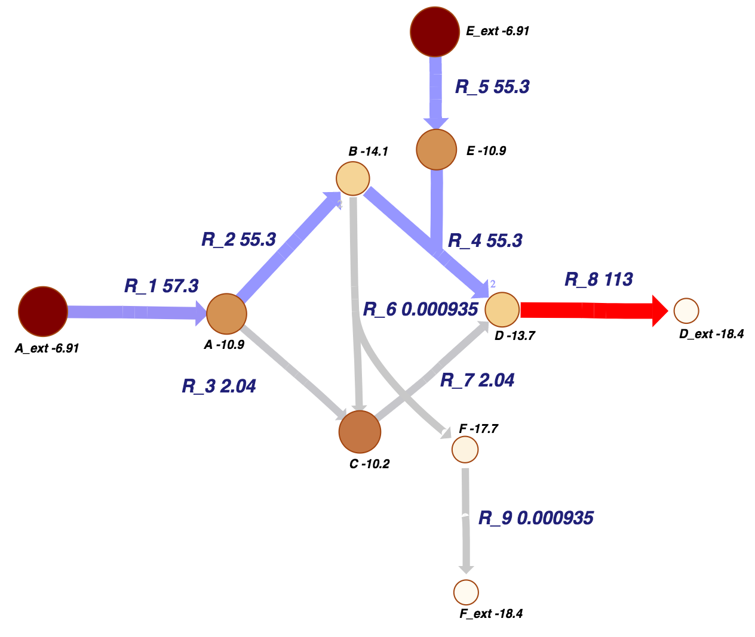
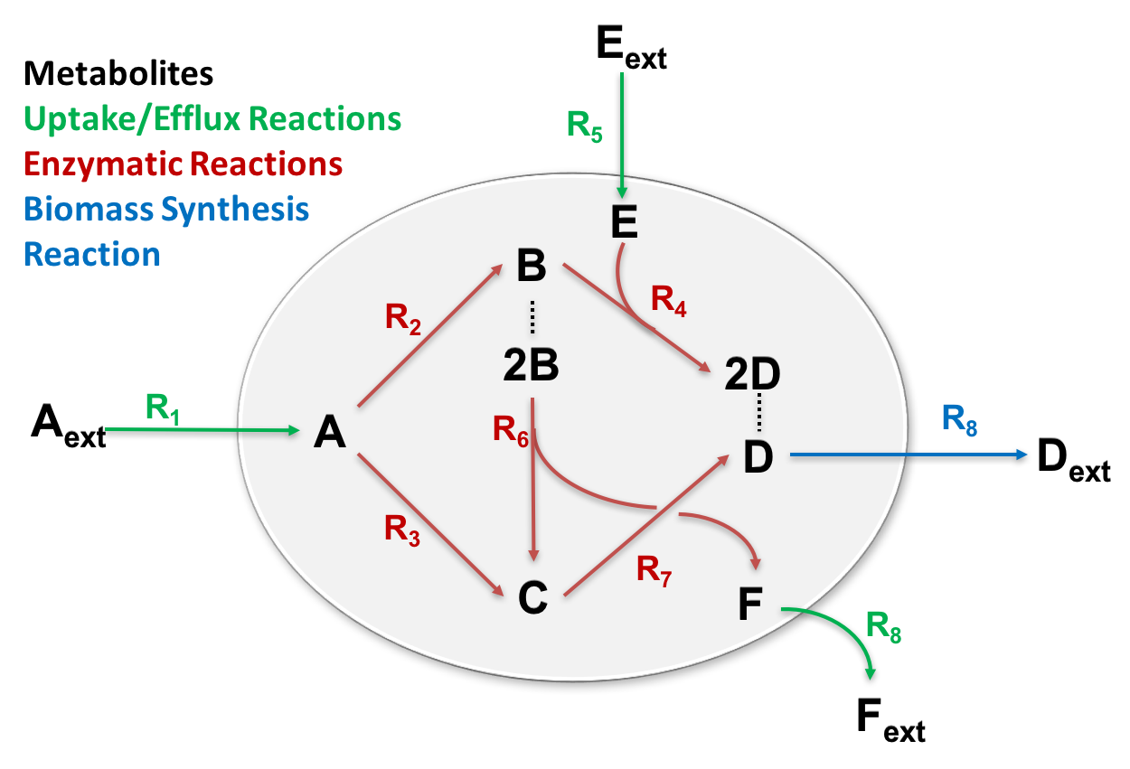
A Thermodynamic Approach for Estimating Metabolite Concentrations
and Fluxes: MENTOS
Neeraj Kumar, Jeremy Zucker and William Cannon
Computational Biology and Bioinformatics Group, Pacific Northwest National Laboratory, Richland WA
Introduction. The modeling of chemical reactions involved in metabolism is very challenging. A genome scale-wide understanding of cellular metabolism is required to quantify thermodynamics and kinetic properties of thousands of reactions and concentrations of corresponding metabolites.
To date, we have lacked the mathematical framework to model the thermodynamics and kinetics of thousands of reactions. As rate parameters necessary for solving the differential equations used in kinetic simulations are difficult to obtain. The most widely adopted methods for metabolic modeling is constraint-based flux modeling such as flux balance analysis (FBA) that relies on fitting experimentally determined growth parameters. The lack of physics in regard to the law of mass action limits the ability of such methods to narrow the solution space to only physically likely solutions. However, the steady state metabolite concentrations are very important for a quantitative understanding of cellular metabolism, as concentrations impact both the reaction free energies (thermodynamics) and rate (kinetics) of metabolic reactions. In the past decade, several promising approaches that include mass action in terms of thermodynamics have been proposed to move beyond constraint-based flux modeling¹⁻⁵.
Theory: Relating Gibbs free energy and thermodynamic driving force (reaction affinity, 𝒜). Elementary reactions can be studied using the law of mass action that do not use rate constants, and instead use the concept of reaction affinities.
Maximize macroscopic entropy production rate for the ABC model.
Entropy production view:
Entropy of thermodynamic driving force
Entropy production rate view:
Growth rate * entropy production
where s⃗ is the vector of reaction stoichiometries which would be replaced by the stoichiometric matrix S for the metabolic reaction network, μ⃗⁰ is the vector of standard chemical potentials, and log c⃗ is the vector of log metabolite concentrations.
This equality constraint is not affine, so any optimization problem will not be convex.
MENTOS Objectives. Entropy production and entropy production rate of metabolic network. The entropy production rate used is the product of the net rate and the entropy change in going from initial products to final reactants.
Energy view:
Chemical potentials and Delta G
Material view:
Log concentrations and fluxes
Motivation. Genome-scale optimization methods such as flux balance analysis (FBA) have been successfully used to predict the steady-state metabolic fluxes that maximize the growth rate, but FBA is incapable of predicting steady state metabolite concentrations. On the other hand, thermodynamic approaches have used chemical potentials to predict reaction direction, but provide no information about the reaction rates.
Maximum entropy production rate provides quantitative measurement where natural systems will move to the most probable state through the fastest path by minimizing energetic costs (thermodynamics).
We present a new thermodynamic optimization method, Maximum ENTropy production rate Of Stoichiometric matrix (MENTOS) that can predict both the steady-state metabolite concentrations and the fluxes that extract energy from the environment as quickly and efficiently as possible, given the constraints of the network and a suitable set of boundary conditions.
The steady-state predictions of metabolite concentrations and fluxes can also be used as initial conditions for thermokinetic simulations that use chemical potentials instead of rate constants to predict dynamics of biological systems.
Entropy production:
Entropy production rate:
The probability distribution of chemical activities (𝒂) in a metabolic network is the normalized chemical activities:
Applying MENTOS to the pruned model of E. coli (iJO1366). Using only knowledge of the external metabolite concentrations and uptake rates, we predicted more than 100 internal metabolite concentrations (M) in the pruned model of E. coli (growth on M9 media) and compared them with the observed concentrations (LC-MS)⁶. Using predicted concentrations, the free energy (DG) of some of the metabolic reactions in E. coli are also compared.
A measure of the evenness of the chemical activities is the entropy which is defined as:
Maximum ENTropy production rate Of Stoichiometric matrix (MENTOS)
Metabolite levels
Predict dynamics of biological systems
Chemical potential
Energy requirement for metabolic pathways
Applying MENTOS to ABC metabolic network model. Maximize macroscopic entropy production rate for the ABC model (Figure 1). The external free energy constraints on the ΔG of each reaction were applied. Below are the given set of constraints that were applied:
Scientific Gaps and Questions. Significant gaps exist between molecular-level analysis that are based on the well accepted laws of physics and cell-level understanding of metabolic pathways. New computational and theoretical methods are needed for large scale modeling of metabolism that predict metabolite levels and characterize the thermodynamics of individual reactions and ultimately energetics requirement of most likely metabolic pathways.
Can metabolic modeling be entirely moved beyond data fitting – make models more predictive by combining fundamental laws of physics/chemistry to biology?
What are the energetic costs to a cell and its metabolism?
Can energetics requirement of most likely metabolic pathways be predicted?
Would it be possible to simulate reaction dynamics of metabolic reactions using chemical potentials in place of rate constants?
External metabolites and uptake rates are not sufficient to predict most internal metabolites
Next steps are to understand which class of metabolites are poorly predicted according to MENTOS.
Improve our optimization approach.
References.
Henry, C. S., Broadbelt, L. J. & Hatzimanikatis, V. (2007) “Thermodynamics-Based Metabolic Flux Analysis.” Biophys. J. 92, 1792.
Chowdhury A., Zomorrodi A. R., and Maranas C. D. (2014) "k-OptForce: integrating kinetics with flux balance analysis for strain design" PLoS Comput Biol, 10, 1003487.
Srienc, F. & Unrean, P. A (2010) “Statistical Thermodynamical Interpretation of Metabolism” Entropy 12, 1921.
Stanford N. J., Lubitz T., Smallbone K., Klipp E., Mendes P., and Liebermeister W. (2013) "Systematic construction of kinetic models from genome-scale metabolic networks" PLoS One, 8, 79195.
(a) Cannon, W. R. (2014) "Simulating metabolism with statistical thermodynamics" PLoS One, 9, 103582. (b). Cannon, W. R. and Baker S. (2017) "Non-steady state mass action dynamics without rate constants: dynamics of coupled reactions using chemical potentials" Phys. Biol., at press 2017.
Park, J. O., Rubin, S. A., Xu, Y.-F., Amador-Noguez, D., Fan, J., Shlomi, T., & Rabinowitz, J. D. (2016) “Metabolite concentrations, fluxes and free energies imply efficient enzyme usage” Nature Chemical Biology, 12, 482.
Where
Figure 1. ABC metabolic network model. The chemical reactions involved in this model including uptake and efflux reactions can be represented as stoichiometric matrix of dimension M (chemical species) x N (chemical reactions).
Acknowledgments
This research was supported the by the U.S. Department of Energy’s Office of Biological and Environmental Research and Microbiomes in Transition Laboratory Directed Research and Development Initiative at PNNL. Computational Biology and Bioinformatics Group, Pacific Northwest National Laboratory, Richland WA 99352.
ABOUT
Pacific Northwest
National Laboratory
The Pacific Northwest National Laboratory, located in southeastern Washington State,
is a U.S. Department of Energy Office of Science laboratory that solves complex problems in energy, national security, and the environment, and advances scientific frontiers in the chemical, biological, materials, environmental, and computational sciences. The Laboratory has an annual budget in excess of $1 billion, and has been managed by Ohio-based Battelle since 1965.
For more information on the science you see here, please contact:
Neeraj Kumar
Pacific Northwest National Laboratory
P.O. Box 999, MS-IN: K1-83
Richland, WA 99352
(509) 372-6902
Neeraj.kumar@pnnl.gov
Notes:
NOTE: Print this poster file at 200% SCALE to result in a physical print measuring 48” wide x 36” tall. All type size notations shown above are based on the final printed size of the poster.
• Contact Digital Duplicating (375-2969, http://digitalduplicating.pnl.gov) to order poster printing and finishing services for your completed poster design.
• Remember to have your poster cleared for public display/distribution through the ERICA Information Release system (http://erica.pnl.gov).
• Sidebar “About PNNL” box is considered optional, and can be removed if space is needed for technical content.

